Slide 1
Comparative Analysis of DL Models for Analysis of Neurological Disorders from Facial Features
B. Tech Final Year Project
Supervised By:
Dr. S. R. Sathe
Group Members:
BT18CSE021
BT18CSE024
BT18CSE025
BT18CSE028

Slide 2
Motivation
Facial nerve paralysis, such as Bell’s palsy is neuromuscular disorder that results in the loss of muscle control on the affected facial region.
An objective and quantitative grading assessment is required for early diagnosis and postoperative recovery.
The diagnosis currently relies on the visual inspection by a clinician.
The approaches for automatic detection/diagnosis have been emerging in recent years. However, most, if not all, of the approaches use handcrafted features and classifiers, the deep-learning based approaches are yet to be developed.

Slide 3
LITERATURE SURVEY
Research Paper | Model | Accuracy
Jocelyn Barbosa (2019) | Logistic Regression on Iris Features | 93.7%
Gee-Sern Wee-Fong (2019) | Deep Hierarchical Network | 91.2%
Wan Syahirah (2019) | Gabor Filters | 73%
*Results are for HB Grade Prediction

Slide 4
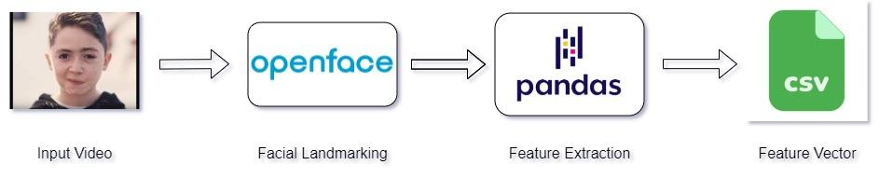
Openface data pipeline

Slide 5
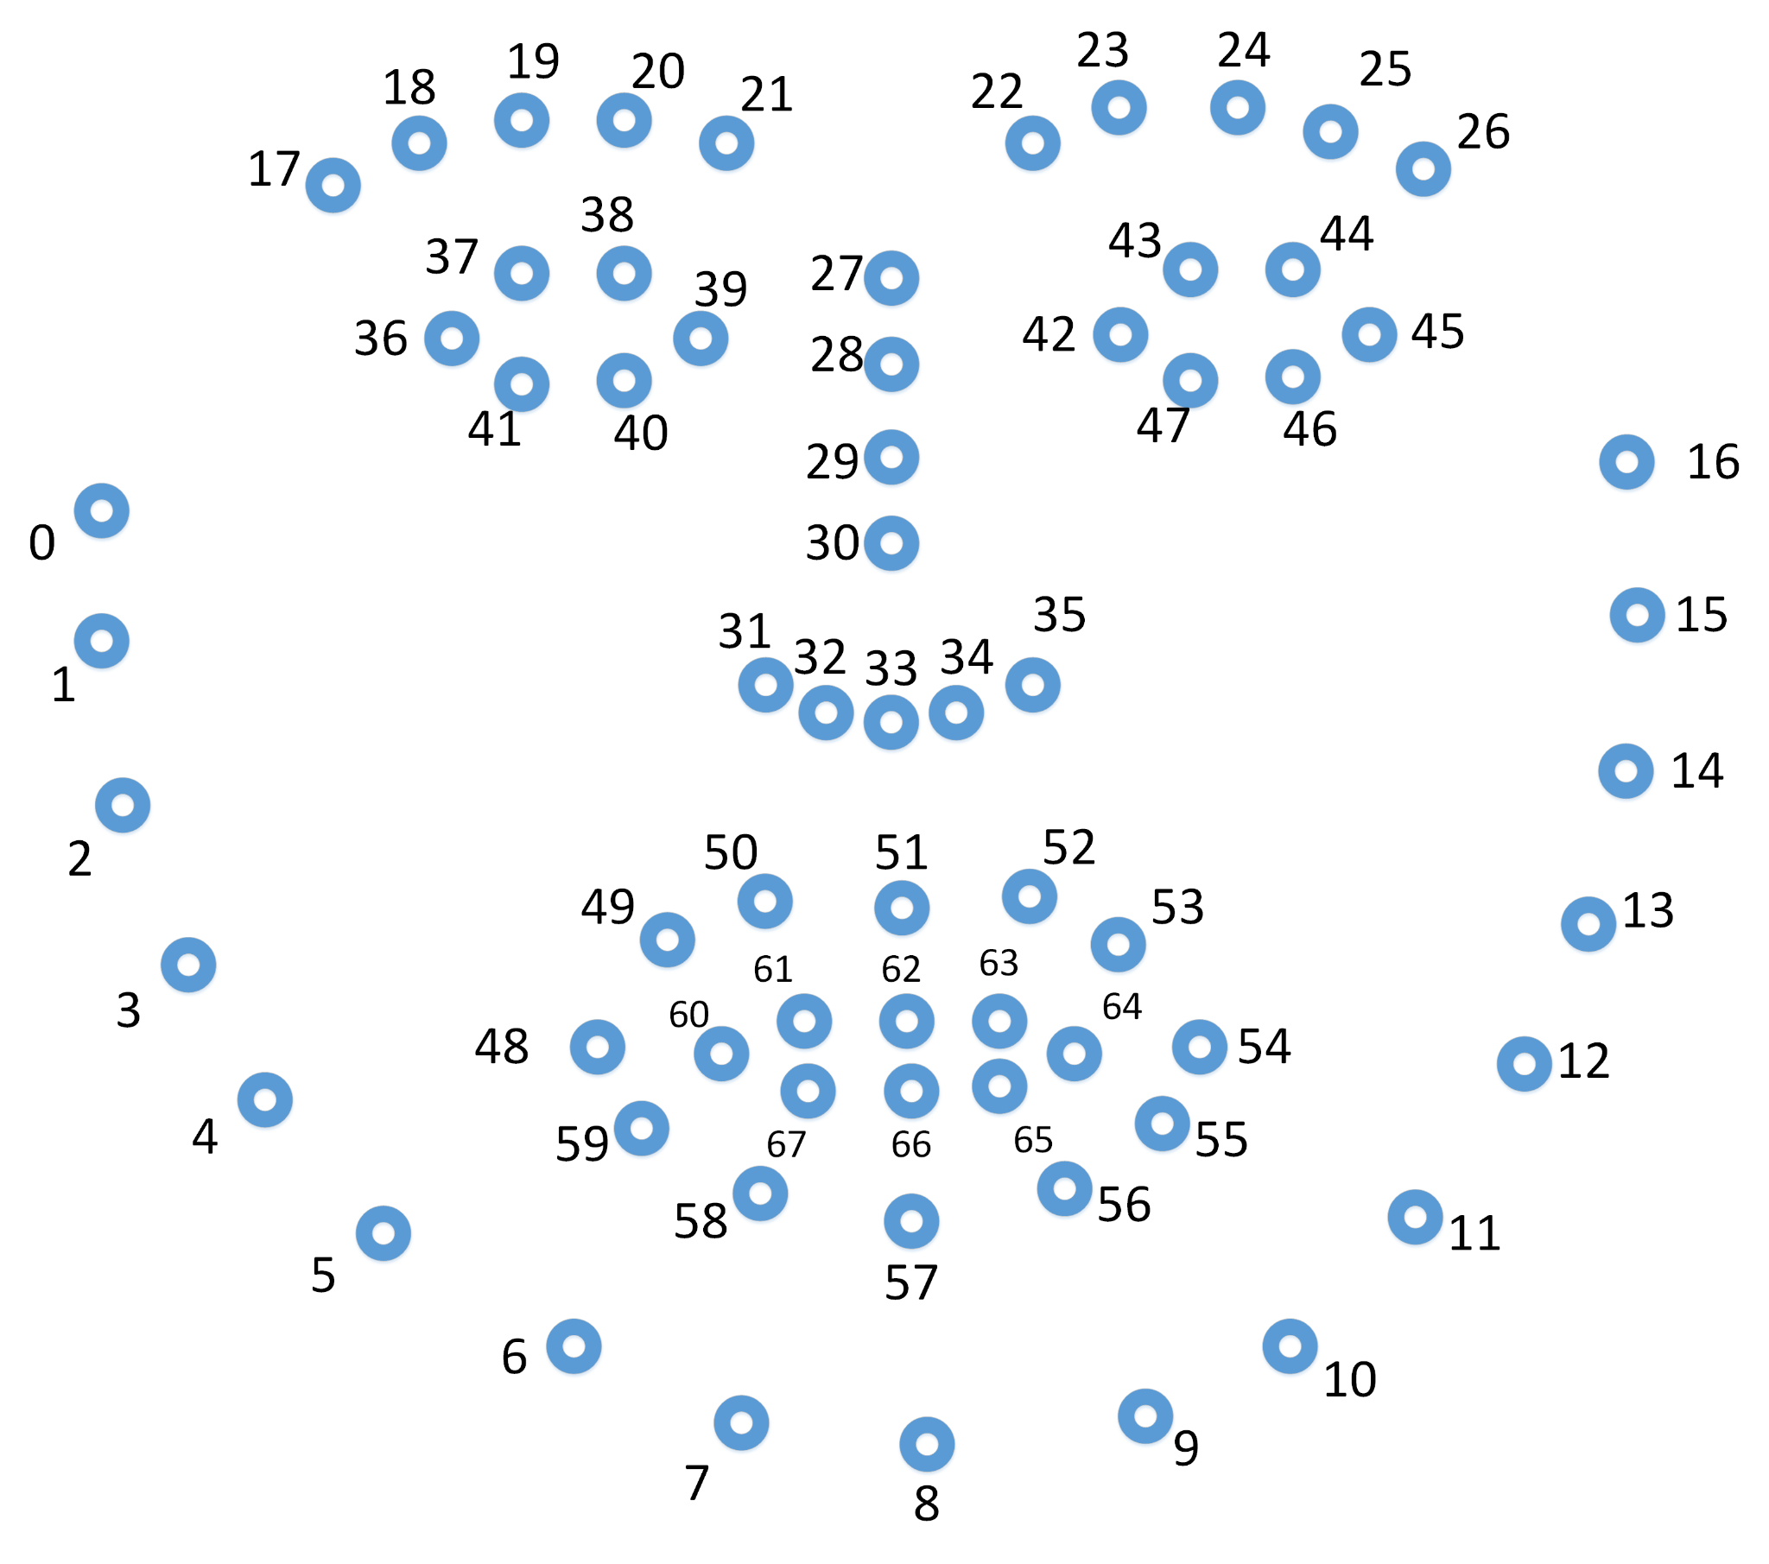
Data processing method
A user video is given to Openface as input, which derives the facial landmarks for the user.
We extract the following landmarks to be used later in the pipeline:
x0 - x67, y0 - y67 (facial landmarks on the 2D plane)
AU01 - AU45 (17 facial action units intensity)
We then use pandas to extract curated features like distances, areas and then we take statistical measures like mean and standard deviation over the complete video to get a single feature point.
We also experimented with splitting the video into blocks of 200 frames but this resulted in overfitting of the data and thus skewed the results.

Slide 6
ML and DNN Experimentation Results
Model | Architecture | Accuracy
Random Forest | 500 Voters | 0.85
Decision Tree | - | 0.75
K-Means | Clusters = 2 | 0.54
DNN Model | 100->50->10->1 | 0.85
* Results are on the dataset created using the hand-crafted features of the output of OpenFace.

Slide 7
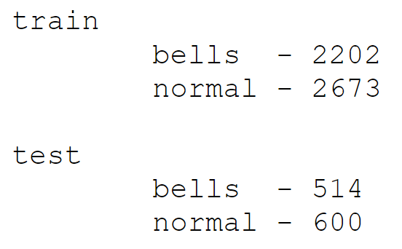
Updated Dataset and Data Flow
Used the YFP dataset.
The dataset is in form of snapshots taken from the video, averaging 150 frames per video.
We ensured each video had near equal contribution to the dataset to ensure a uniform distribution in the dataset.
We crop the images to bound the face using Haar filters/MTCNN to prevent any biases in training by the environment.
This bounded image is taken as the feature vector for our CNN model.

Slide 8
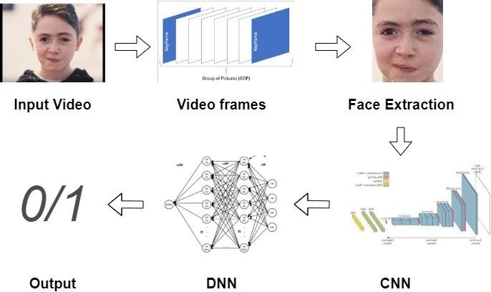
Prediction Pipeline for CNN

Slide 9
CNN Experimentation & Results
Base | Layers | Accuracy | Precision | Recall
VGG16 | 64->32->16 | 0.9476 | 0.9890 | 0.9054
ResNet | 64->32->16 | 0.8488 | 0.9728 | 0.7189
VGG19 | 64->32->16 | 0.8410 | 0.8655 | 0.8077
VGG16 | 128->64->32 | 0.9365 | 0.9955 | 0.8780
ResNet + UF | 128->64->32 | 0.9647 | 0.9753 | 0.9536
VGG19 | 128->64->32 | 0.6835 | 0.6305 | 0.8958
VGG16 | 16->8->4 | 0.9234 | 0.9907 | 0.8554
ResNet + UF | 16->8->4 | 0.8982 | 0.8810 | 0.9217
VGG19 | 16->8->4 | 0.9264 | 0.8944 | 0.9679
VGG16 + R | 64->32->16 | 0.9486 | 0.9891 | 0.9078

Slide 10
What we learned from CNNs
The best model we obtained was using ResNet as the base model with trainable batch normalization layers.
Batch normalization layers used pre-trained statistics instead of the new statistics for normalization. This is why it was important to unfreeze these layers.
Training accuracy was steeply increasing with the no of epochs. To curb overfitting, we tried dropout regularization to ensure that the net generalized well.
ResNet had an output layer of 2048 size, which is why ResNet worked well with appended layers of larger size. This is also why ResNet generally required 15 epochs for training.
VGG had an output layer of 512 size, which is why VGG worked well with appended layers of smaller size.
Increasing the no of epochs led to overfitting of the data.
Legend
R - Regularization
UF - Unfreezing Batch Normalization Layers
Number of epochs ranged from 5-15.

Slide 11
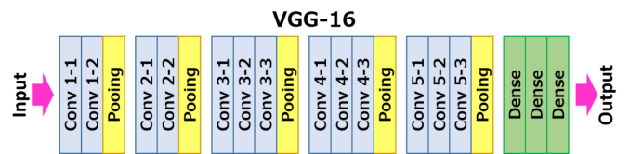
CNN Model Variants
Base Model | Dropout value | Layers | Accuracy | Precision | Recall
VGG16 | 0.4 | 64->32->16 | 0.9476 | 0.9749 | 0.9266
VGG16 | 0.4 | 64 | 0.9237 | 0.8899 | 0.9795
VGG16 (Trainable Base Layers) | 0.4 | 64 | 0.9446 | 0.9385 | 0.9517
VGG16 (Truncated Base Model) | 0.4 | 64 | 0.9859 | 0.9728 | 1
VGG16 (Data Augmentation) | - | 64 | 0.9449 | 0.9175 | 0.9863

Slide 12
CNN Variants
VGG16 acted as the best base model for these modifications given the steady nature of its training (ResNet had fluctuating metrics).
To prevent overfitting, we added dropout layers to ensure that relevant features are reinforced and non-relevant features are punished in training.
To ensure that the model is resilient to spatial cues, we added data augmentation techniques like rotation and sheer.
We tried unfreezing layers from the base model to fine tune the base model to our specific requirements.
We clipped of the last block from the VGG16 model to acquire low level facial features that provide a more relevant feature vector.

Slide 13
LSTMs
A single frame cannot accurately represent the overall features required to give a diagnosis.
Correlating the information available in multiple frames can provide more interesting features.
A flickering eyelid is more comprehensive compared to an open/close eyelid as a source of information.
Fluctuations in metrics were observed.
Training |  |  | Testing
Accuracy | Precision | Recall | Accuracy | Precision | Recall
0.8704 | 0.8462 | 0.8627 | 0.9083 | 0.8571 | 0.96

Slide 14
Live Prediction
A single frame cannot accurately represent the overall features required to give a diagnosis.
So we combine the output of our model on multiple frames to strengthen the prediction.
We pass each frame through our model and get the prediction for that frame.
We can now use the prediction history to get a final value.
Designed a model to perform live prediction on a video, that gives real time prediction for facial paralysis, taking into account change in environment.
An Exponentially Weighted Moving Average score is generated. This allows weightage for historical information and allows flexibility towards changing environment.

Slide 15
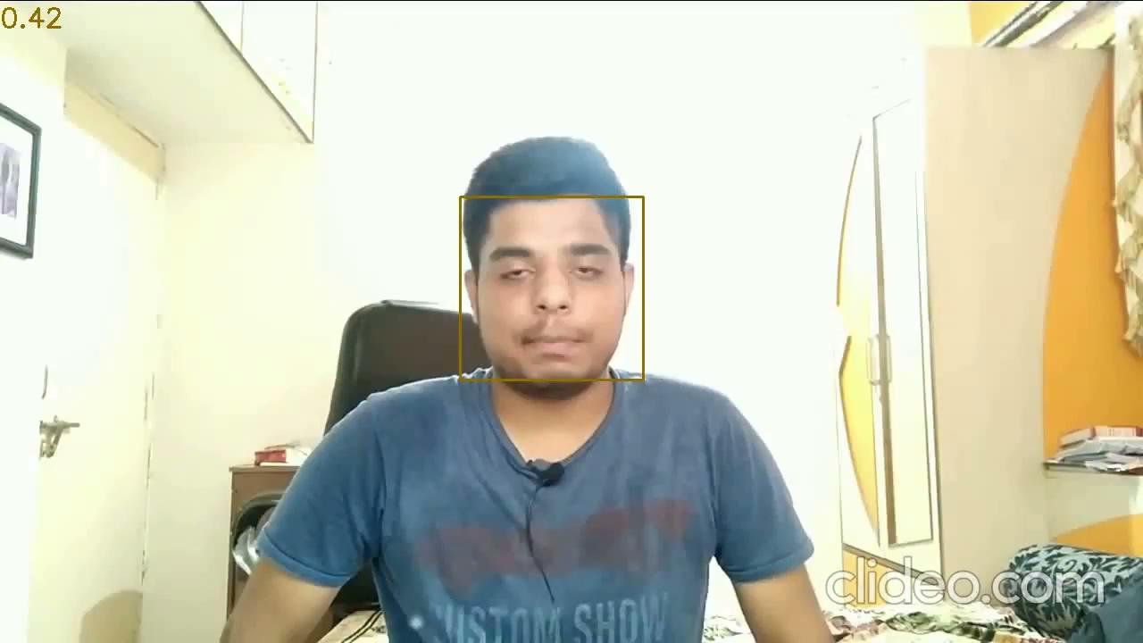
Live Prediction Output

Slide 16
Grade Prediction
Grade Prediction deals with the assessment of the degree of disorder in conjunction to the presence of the disorder.
House-Brackmann Scale is a standard scale used to assess the degree of paralysis starting from grade 1 (normal) to grade 6 (total paralysis).
In our model, we use a custom Scale starting from grade 1 to grade 3.
Grade 1 -> Normal
Grade 2 -> Slight
Grade 3 -> Severe
This scale is preferred to combat the smaller size of the dataset, ensuring equi-distribution of sample points for each class and
We model the mapping of the predictors to our custom scale as a multi classification problem.

Slide 17
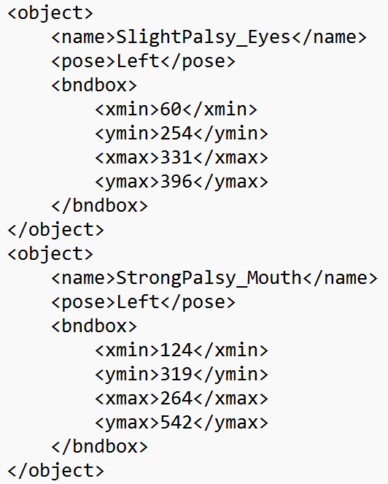
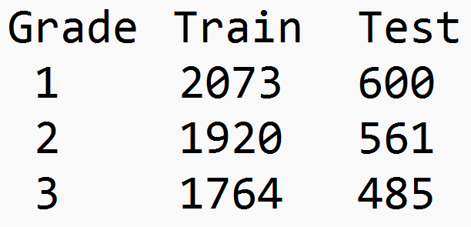
YFP Dataset
XML files describe the severity of the disorder for the Eyes and Mouth region.
Patient strongly affected in both regions are classified as ‘Severe’ i.e. 3.
Patients affected in at least affected in one region are classified as ‘Slight’ i.e. 2.

Slide 18
Grade Classifier Results
Our grade classifier is based on VGG16 truncated model as our basis. This model best performed in case of the 0/1 classification problem.
It uses Softmax as the activation function to deal with categorical classification.
Training |  |  | Testing
Accuracy | Precision | Recall | Accuracy | Precision | Recall
0.7001 | 0.7042 | 0.6950 | 0.72 | 0.7227 | 0.7138
In the YFP dataset, grades have been assigned for for both the eyes as well as for the mouth.
It will be optimal to train two separate region specific classifiers.
Extracting the regional components can be done using Haar cascades.
We can then combine the results of the two models(run in parallel) and make a final grade prediction.

Slide 19
REFERENCES
A Review on Automated Facial Nerve Function Assessment from Visual Face Capture - Jianwen Lou, Hui Yu, Senior Member, IEEE, Fei-Yue Wang, Fellow, IEEE
Deep Hierarchical Network With Line Segment Learning for Quantitative Analysis of Facial Palsy - GEE-SERN JISON HSU , (Senior Member, IEEE), JIUNN-HORNG KANG, AND WEN-FONG HUANG, (Member, IEEE)
Region Based Parallel Hierarchy Convolutional Neural Network for Automatic Facial Nerve Paralysis Evaluation - Xin Liu, Yifan Xia , Hui Yu , Senior Member, IEEE, Junyu Dong , Member, IEEE, Muwei Jian, and Tuan D. Pham, Senior Member, IEEE

Slide 20
Thank You

